Slide 1
Results for Master Thesis
Jennifer Neumaier
Draft: 09.05.2022

Slide 3
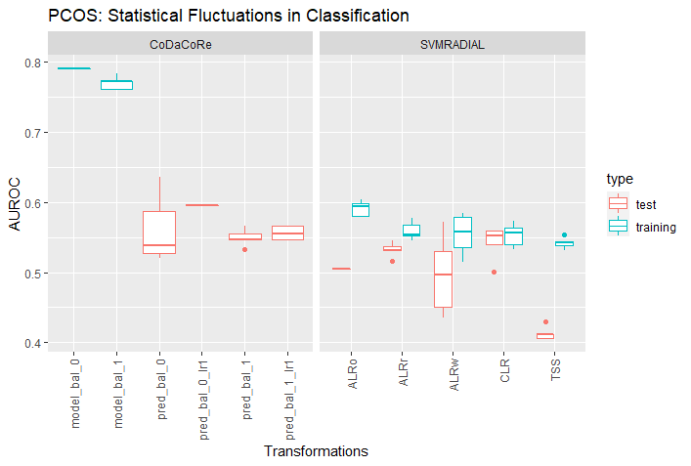
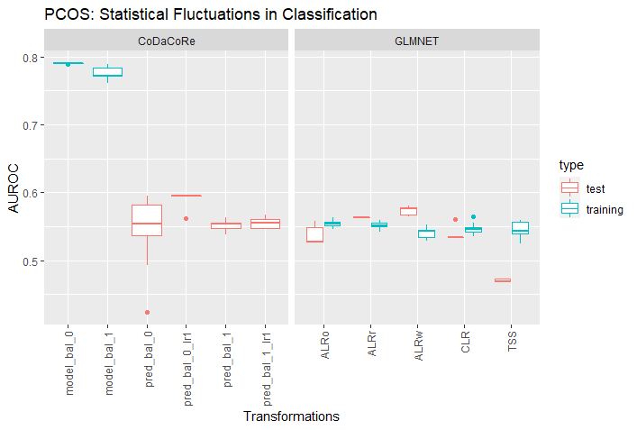
PCOS classification (PCOS_Riikka)
Data: D:\Master\Master Biologie\Sommersemester 2022\Master thesis\Github\out\PCOS\glmnet
jennifer.neumaier@t-online.de
Notes:
- 10% abundance filter
- Nonlinear (left) and linear (right)
svmRadial (5 repeats with 2x CV)
Glmnet (10 repeats with 5x CV)
Codacore: overfitting
Svmradial/glmnet: TSS worst test performances, ALRo better in glmnet, CLR equally good performances

Slide 4
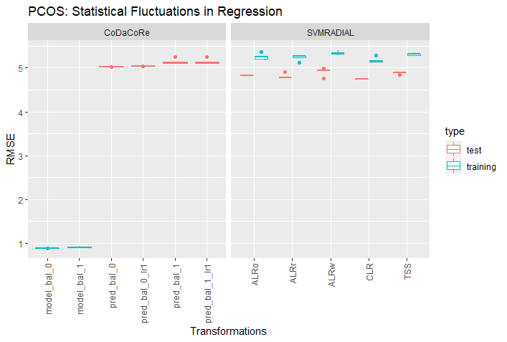
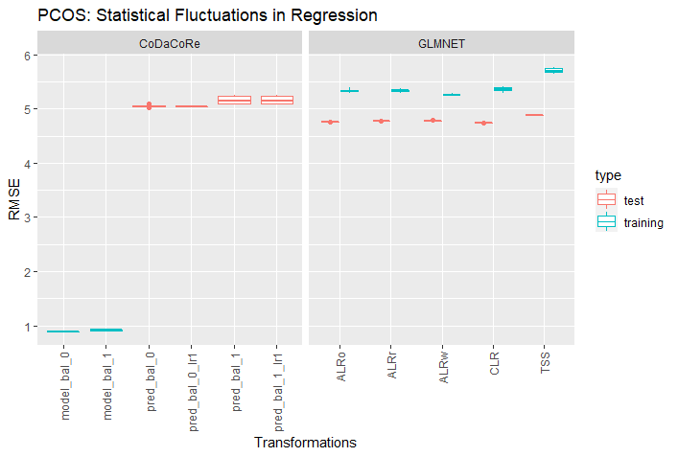
PCOS regression (BMI)
Data: D:\Master\Master Biologie\Sommersemester 2022\Master thesis\Github\out\PCOS\svmRadial
jennifer.neumaier@t-online.de
Notes:
- 10% abundance filter
- Nonlinear (left) and linear (right)
svmRadial (5 repeats with 2x CV)
Glmnet (10 repeats with 5x CV)
Codacore: overfitting
Svmradial/glmnet: continuously underfitting, but all performances very similar without mich fluctuation

Slide 5
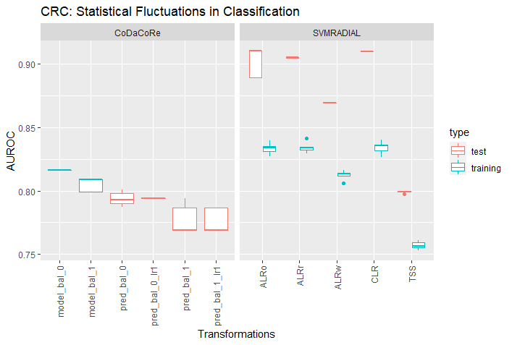
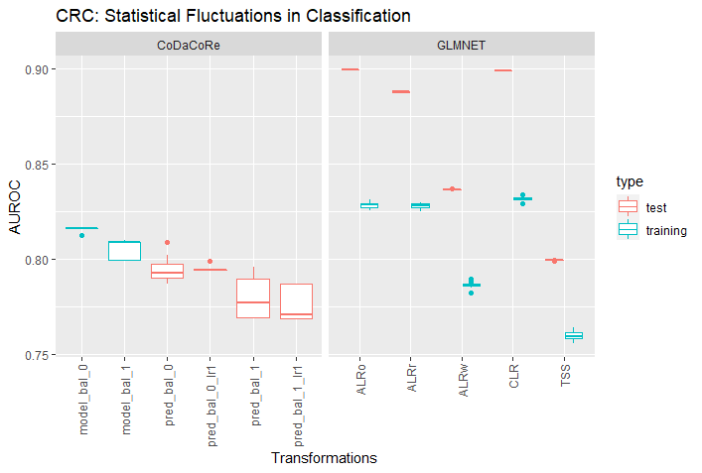
CRC classification (Group)
Data: D:\Master\Master Biologie\Sommersemester 2022\Master thesis\Github\out\CRC\glmnet
jennifer.neumaier@t-online.de
Notes:
- 10% abundance filter
- Nonlinear (left) and linear (right)
svmRadial (5 repeats with 2x CV)
Glmnet (10 repeats with 5x CV)
Codacore: a bit underfitting, but a lot better than in PCOS
Svmradial/glmnet: TSS and ALRw worst test performances, ALRo and CLR show similarly good performances, but still underfitting in both models

Slide 6
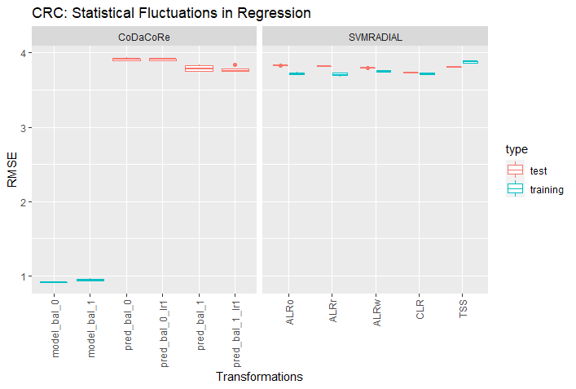
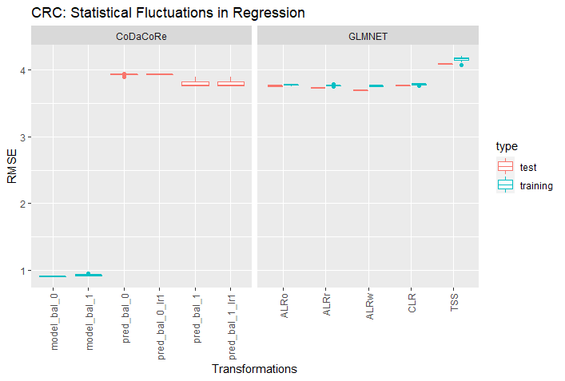
CRC regression (BMI)
Data: D:\Master\Master Biologie\Sommersemester 2022\Master thesis\Github\out\CRC\svmRadial
jennifer.neumaier@t-online.de
Notes:
- 10% abundance filter
- Nonlinear (left) and linear (right)
svmRadial (5 repeats with 2x CV)
Glmnet (10 repeats with 5x CV)
Codacore: overfitting
Svmradial/glmnet: continuously underfitting, but all performances very similar without mich fluctuation (TSS perhaps worst performances and also lambda 1 better than lambda 0)

Slide 7
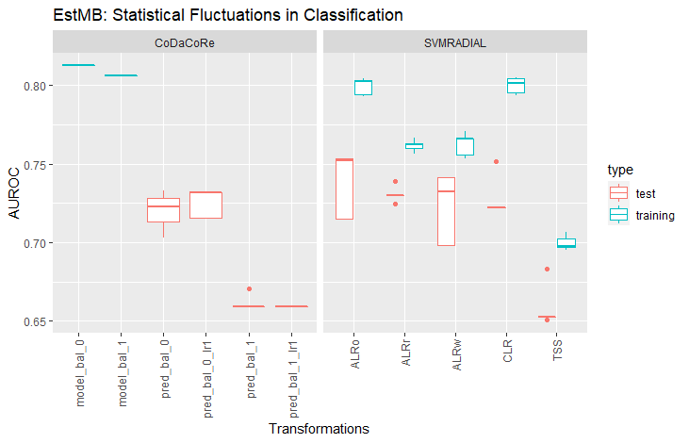
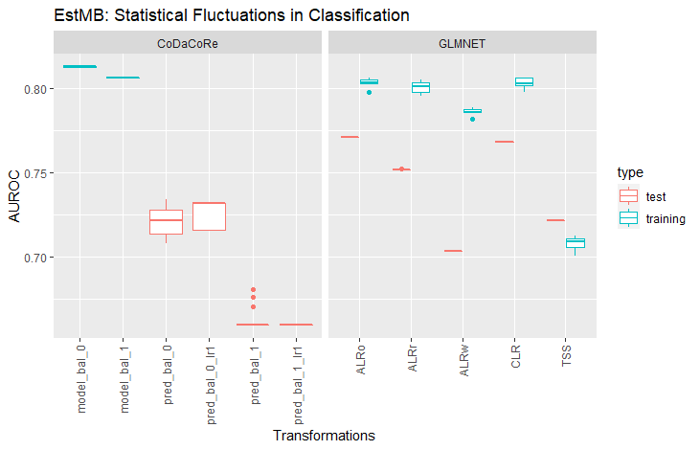
EstMB classification (E11)
Data: D:\Master\Master Biologie\Sommersemester 2022\Master thesis\Github\out\EstMB\E11\glmnet
jennifer.neumaier@t-online.de
Notes:
90% abundance filter
Nonlinear (left) and linear (right)
svmRadial (5 repeats with 2x CV)
Glmnet (5 repeats with 5x CV)
Codacore: a bit underfitting, with lambda 0 showing better performances than lambda 1
Svmradial/glmnet: TSS and ALRw worst test performances (ALRr also in svmRadial), ALRo and CLR show similarly good performances, but still underfitting in both models

Slide 8

EstMB regression (BMI)
Data: D:\Master\Master Biologie\Sommersemester 2022\Master thesis\Github\out\EstMB\E11 (or BMI)\svmRadial
jennifer.neumaier@t-online.de
Notes:
90% abundance filter
Nonlinear (left) and linear (right)
svmRadial (5 repeats with 2x CV)
Glmnet (5 repeats with 5x CV)
Codacore: clearly overfitting
Svmradial/glmnet: performances are very similar (perhaps TSS worse than the rest)

Slide 9
Summary
Around 1000 features give a good basis for model -> statistical fluctuations not high, independent of low or high correlations or classification/regression
Codacore doesn‘t work well on regression tasks (or at least behave in the same manner as nonlinear and linear models)
CLR and ALRo show similar performances -> if ALR is used, it is best to chose the best one (but random works surprisingly well)
TSS usually shows worst performances
Lambda has an influence on codacore, so a hypertuning could be an advantage (or train both models like here)
jennifer.neumaier@t-online.de

Slide 10
Concept
Non-leaky
leaky
Data set
Data set
Merging with metadata
Imputation on whole data set
Only 10% abundance filtering used
Splitting data
Transformations on whole data set
Imputation separately on test and train set
Merging with metadata
Transformation separately on test and train set
Splitting data
Modeling
Modeling
jennifer.neumaier@t-online.de
Notes:
NB! Got error for test set that its not enough data to use GBM -> Imputation will be conducted on whole data set

Slide 11
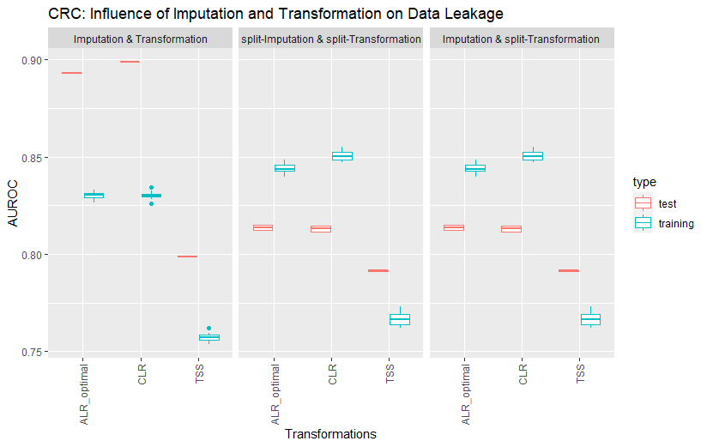
Data leakage with and without imputation in CRC
jennifer.neumaier@t-online.de
5/17/2022

Slide 12
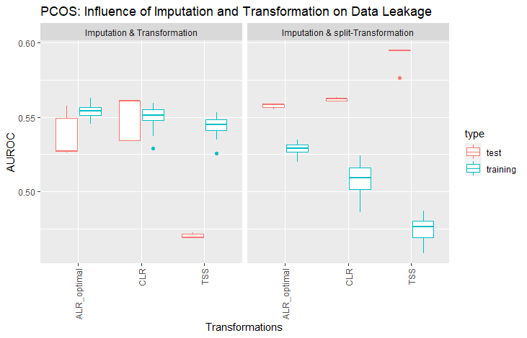
Data leakage without imputation in PCOS
jennifer.neumaier@t-online.de
5/17/2022
Notes:
Only without imputation, as test set does not have enough data for t hypertuning in GBM

Slide 13
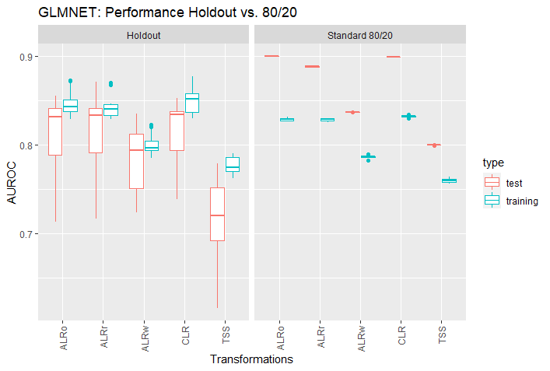
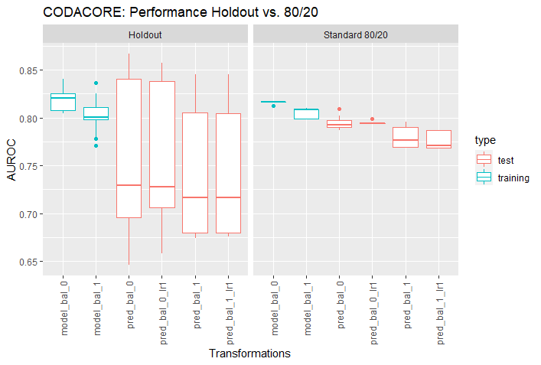
Holdout vs 80/20 THESIS
Data: D:\Master\Master Biologie\Sommersemester 2022\Master thesis\Github\out\CRC_holdout
jennifer.neumaier@t-online.de
Notes:
10% abundance
CRC data set
Holdout: all 5 holdout set performances combined (AUS, USA, CHI, FRA, GER)
Test performances depend highly on chosen holdout set, for both codacore and glmnet, with worst performances again in ALRw and TSS
High bias depending on holdout set -> standard 80/20 split shows underfitting, but perhaps more unbiased

Slide 14
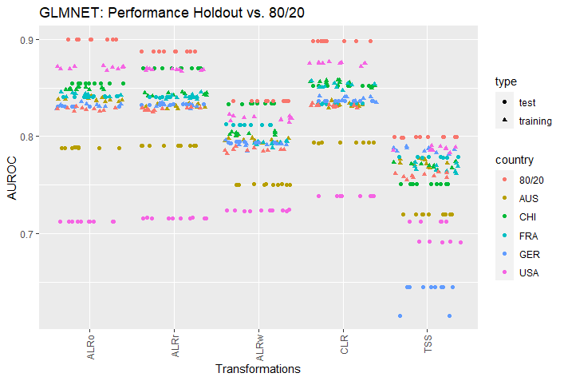
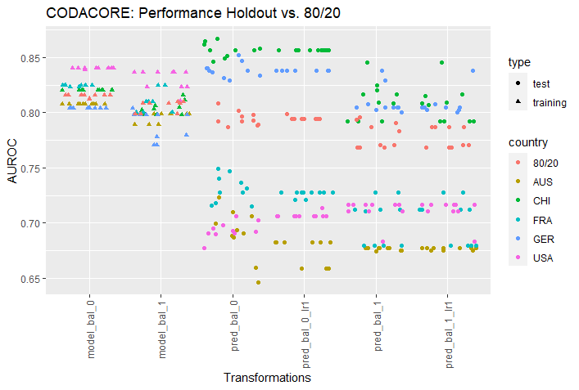
Holdout vs 80/20 DETAILS
Data: D:\Master\Master Biologie\Sommersemester 2022\Master thesis\Github\out\CRC_holdout
A
B
jennifer.neumaier@t-online.de
Notes:
AUS and USA show in both glmnet and codacore bad predictions as test set
choice of holdout test set affects ml models and also codacore (which makes sense, as it is also a linear model in the background)
Same as graphs before, but here single values are plotted to see where discrepancies in former graph come from

Slide 15
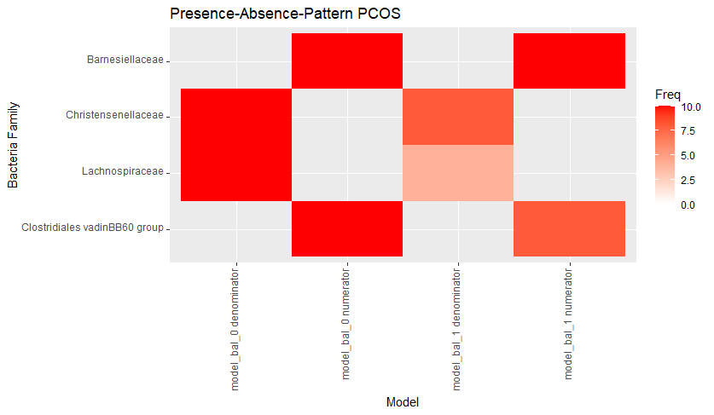
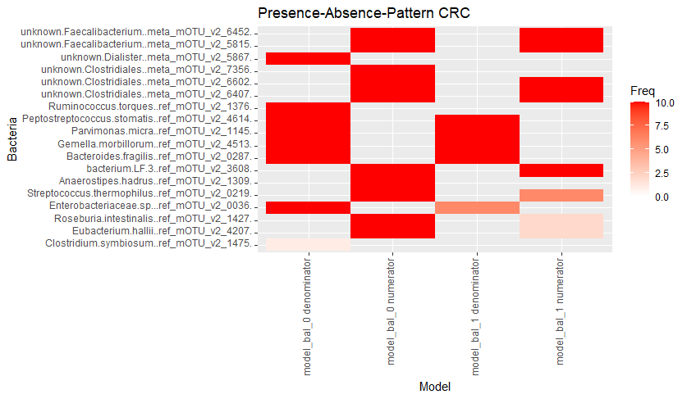
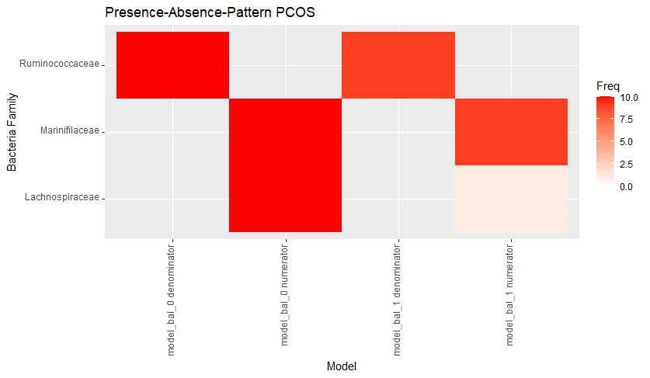
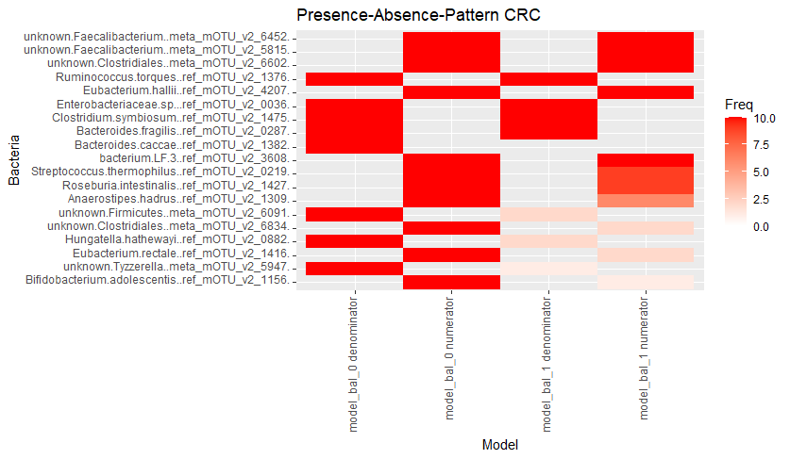
10% abundance
10% abundance
50% abundance
50% abundance
5/17/2022
jennifer.neumaier@t-online.de
Notes:
Numerators and denominators found by codacore over 10 rounds per model
For PCOS and CRC
For high correlation test sets codacore finds similar denominators and numerators
Low correlation: 1 overlap in Lachnospiraceae

Slide 16
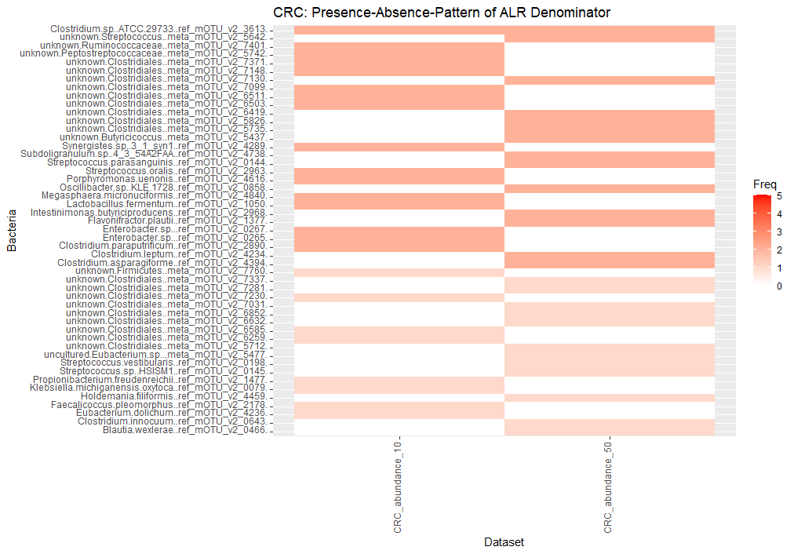
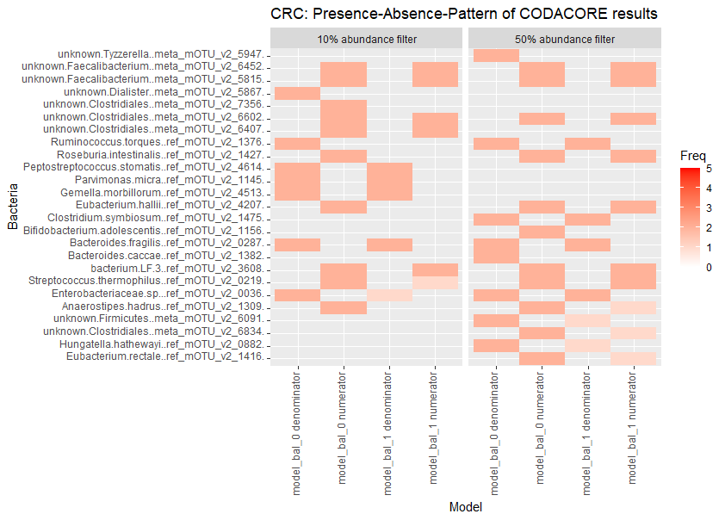
Attempt: ALR vs PWLR
Notes:
2x ALR top 20 in ALRo CRC vs 2x codacore denominators
no intersect
- Attempt to see if codacore and ALRo find the same families (they do not)

Slide 17
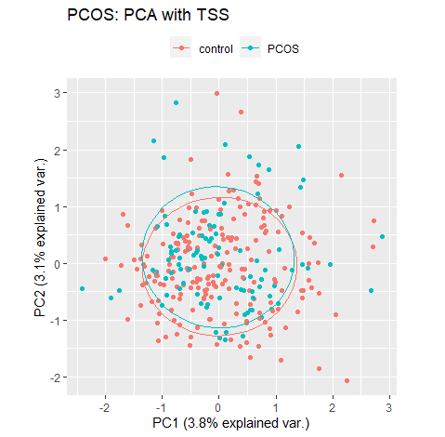
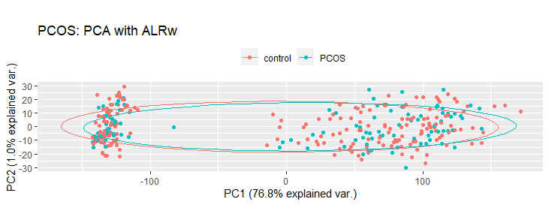
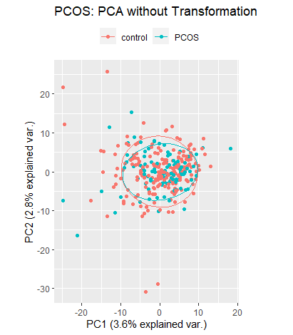
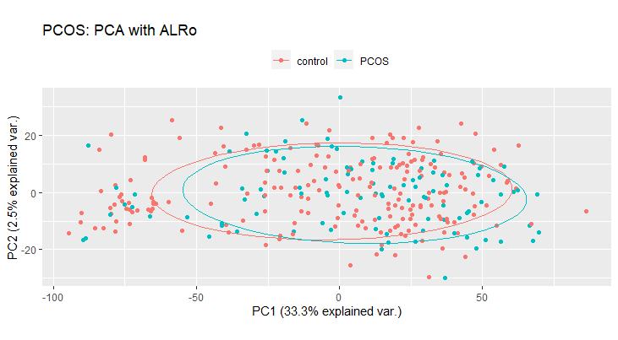
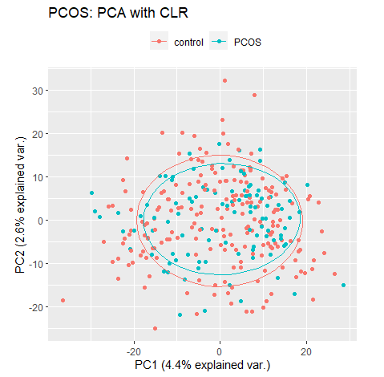
Visualization: PCA
Notes:
PCAs are centered, but not scaled
TSS is centered and scaled
- ALR spreads out data points and has highest explained variances.

Slide 18
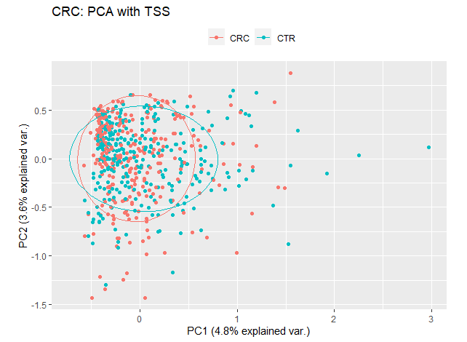
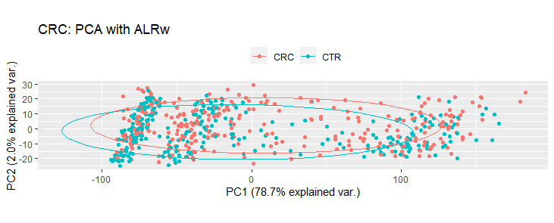
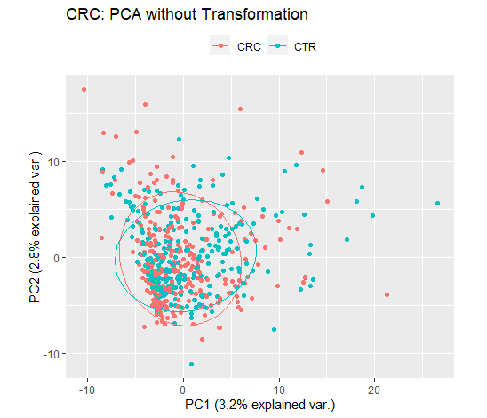
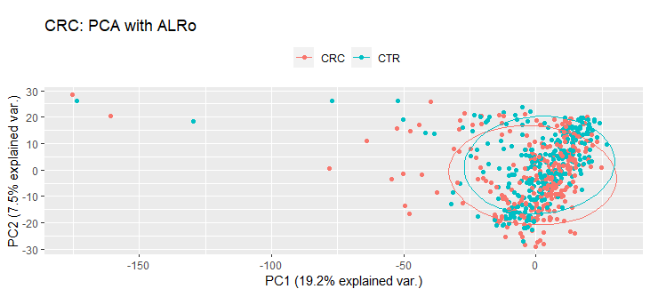
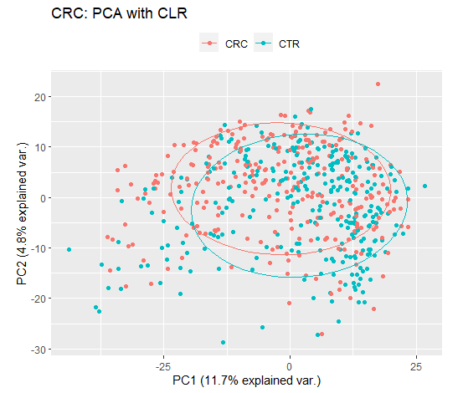
Visualization: PCA
Notes:
PCAs are centered, but not scaled
TSS is centered and scaled
- ALR spreads out data points and has highest explained variances.
They do not explain how machine learning models reach 80% prediction...

